Slide 1

Clustering – Part 3
Data Mining– Final Week 4
Humaira Anzum Neha
Lecturer
Dept of CSE, UIU
humaira@cse.uiu.ac.bd

Slide 2

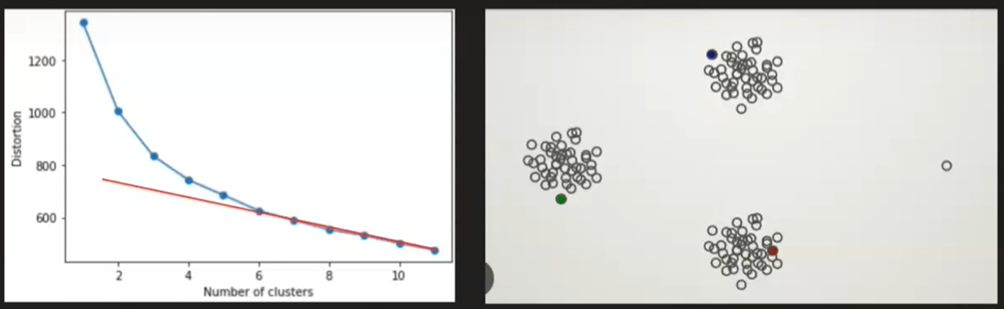
Density Based Clustering
Problem with K-Mean
Need to specify no of clusters
Sensitive to outliers
K-Means and Hierarchical Clustering both fail in creating clusters of arbitrary shapes. They are not able to form clusters based on varying densities. That’s why we need DBSCAN clustering.

Slide 3
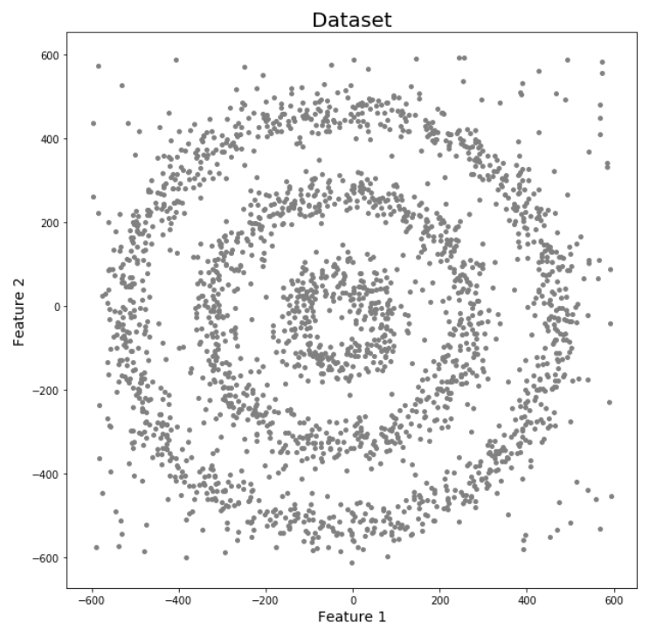
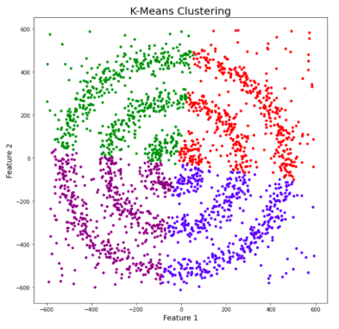
Density Based Clustering

Slide 4
Density Based Clustering

Slide 5
Density Based Clustering
Sadly, both of them failed to cluster the data points. Also, they were not able to properly detect the noise present in the dataset.

Slide 6
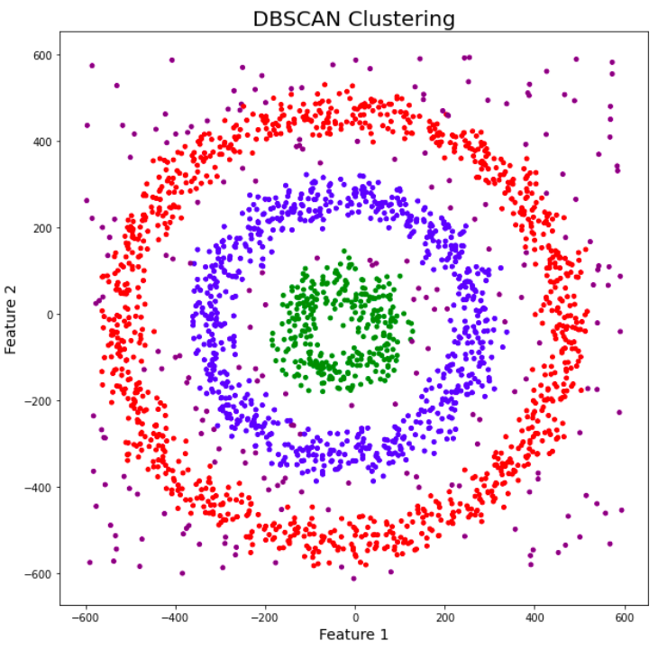
Density Based Clustering

Slide 7
What is DBSCAN Clustering?
DBSCAN stands for Density-Based Spatial Clustering of Applications with Noise.
DBSCAN is a density-based clustering algorithm that works on the assumption that clusters are dense regions in space separated by regions of lower density.
It groups ‘densely grouped’ data points into a single cluster. It can identify clusters in large spatial datasets by looking at the local density of the data points.
The most exciting feature of DBSCAN clustering is that it is robust to outliers.
It also does not require the number of clusters to be told beforehand, unlike K-Means, where we have to specify the number of centroids.

Slide 8
Parameters Required for DBSCAN Algorithm
eps (ε): This parameter defines the radius of a neighborhood around a data point. Points within this distance are considered neighbors of the central point.
minPts: This parameter represents the minimum number of points required within the ε-neighborhood of a point to classify it as a core point. A core point is considered to be dense enough to be part of a cluster.

Slide 9

Walkthrough of DBSCAN
DBSCAN creates a circle of epsilon radius around every data point and classifies them into Core point, Border point, and Noise.
A data point is a Core point if the circle around it contains at least ‘minPoints’ number of points.
If the number of points is less than minPoints but at least one core points, then it is classified as Border Point.
Around any data point within epsilon radius, if the number of points is less than minPoints but there are no core points, then it treated as Noise.

Slide 10
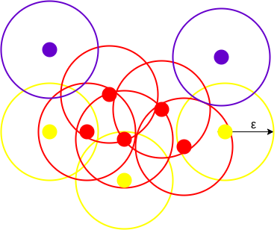
Walkthrough of DBSCAN
DBCAN with minPoints = 3
All the data points with at least 3 points in the circle including itself are considered as Core points represented by red color.
All the data points with less than 3 point in the circle including itself but at least one core point are considered as Border points. They are represented by yellow color.
Noise represented by the purple color.

Slide 11
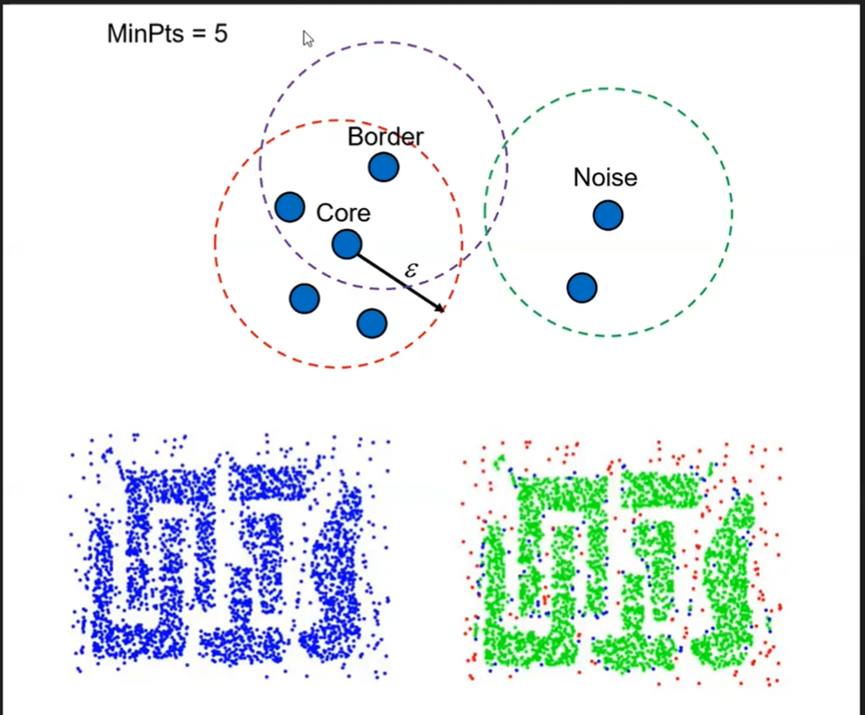
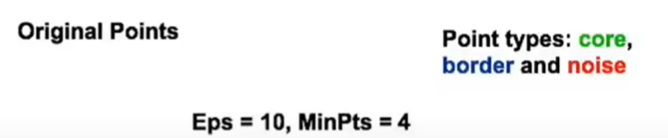
Walkthrough of DBSCAN

Slide 12
Walkthrough of DBSCAN
Reachability and Connectivity
Reachability states if a data point can be accessed from another data point directly or indirectly
Connectivity states whether two data points belong to the same cluster or not.
In terms of reachability and connectivity, two points in DBSCAN can be referred to as:
Directly Density-Reachable
Density-Reachable
Density-Connected

Slide 13
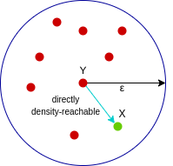
Walkthrough of DBSCAN
Reachability and Connectivity
Directly Density-Reachable
Density-Reachable
Density-Connected
A point X is directly density-reachable from point Y w.r.t epsilon, minPoints if,
X belongs to the neighborhood of Y, i.e, dist(X, Y) <= epsilon
Y is a core point
Here, X is directly density-reachable from Y, but vice versa is not valid.

Slide 14
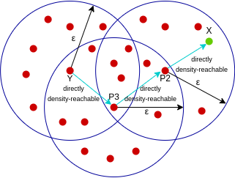
Walkthrough of DBSCAN
Reachability and Connectivity
Directly Density-Reachable
Density-Reachable
Density-Connected
A point X is density-reachable from point Y w.r.t epsilon, minPoints if there is a chain of points p1, p2, p3, …, pn and p1=X and pn=Y such that pi+1 is directly density-reachable from pi
Here, both X and Y are density-reachable from O, therefore, we can say that X is density-connected from Y.

Slide 15
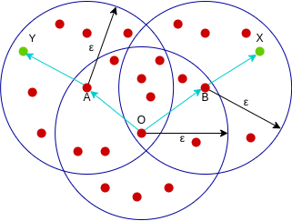
Walkthrough of DBSCAN
Reachability and Connectivity
Directly Density-Reachable
Density-Reachable
Density-Connected
A point X is density-connected from point Y w.r.t epsilon and minPoints if there exists a point O such that both X and Y are density-reachable from O w.r.t to epsilon and minPoints.
Here, X is density-reachable from Y with X being directly density-reachable from P2, P2 from P3, and P3 from Y. But, the inverse of this is not valid.

Slide 16
Walkthrough of DBSCAN
DBSCAN Algorithm
Step 1: Identify all points as either core point, border point or noise point
Step 2: For all of the unclustered core points
  Step 2a- Create a new cluster
  Step 2b- Add all points that are unclustered and density connected to the current point into this cluster
Step 3: For each unclustered border point assign it to the cluster of nearest core point
Step 4: Leave all the noise points as it is.

Slide 17
Walkthrough of DBSCAN
DBSCAN Algorithm
Step 1: Identify all points as either core point, border point or noise point
Step 2: For all of the unclustered core points
  Step 2a: Create a new cluster
  Step 2b: Add all points that are unclustered and density connected to the current point into this cluster
Step 3: For each unclustered border point assign it to the cluster of nearest core point
Step 4: Leave all the noise points as it is.

Slide 18
Walkthrough of DBSCAN

Slide 19
Walkthrough of DBSCAN
Step 1: Identify all points as either core point, border point or noise point
Core Point
Border Point
Noise

Slide 20
Walkthrough of DBSCAN
Step 2: For all of the unclustered core points
6
7
2
3
1
8
5
4
Core Point
Border Point
Noise

Slide 21
Walkthrough of DBSCAN
Step 2: For all of the unclustered core points
  Step 2a: Create a new cluster
6
7
2
3
1
8
5
4
Core Point
Border Point
Noise

Slide 22
Walkthrough of DBSCAN
Step 2: For all of the unclustered core points
  Step 2a: Create a new cluster
  Step 2b: Add all points that are unclustered and density connected to the current point into this cluster
6
7
2
3
1
8
5
4
Core Point
Is 1 and 2 density connected? If yes add it to the cluster.
Border Point
Noise

Slide 23
Walkthrough of DBSCAN
Step 2: For all of the unclustered core points
  Step 2a: Create a new cluster
  Step 2b: Add all points that are unclustered and density connected to the current point into this cluster
6
7
2
3
1
8
5
4
Core Point
Is 1 and 3 density connected? If yes add it to the cluster.
Border Point
Noise

Slide 24
Walkthrough of DBSCAN
Step 2: For all of the unclustered core points
  Step 2a: Create a new cluster
  Step 2b: Add all points that are unclustered and density connected to the current point into this cluster
6
7
2
3
1
8
5
4
Core Point
Border Point
Noise

Slide 25
Walkthrough of DBSCAN
Step 3: For each unclustered border point assign it to the cluster of nearest core point
6
7
2
3
1
8
5
4
Core Point
Border Point
Noise

Slide 26
Advantages & Limitations
  Advantage:
    Robust to outliers
    No need to specify clusters
    Can find arbitrary shaped clusters
    Only 2 hyperparameters to tune ( epsilon and minPts)
  Limitations:
    Sensitivity to hyperparameters.
    Difficulty with varying density clusters. (sparse dense). Why? Think
    Does not predict

Slide 27
Visualization tool
https://www.naftaliharris.com/blog/visualizing-dbscan-clustering/

